Slide 1

Computing 101
Kein plan

Slide 2



Agenda
Introduction – (what is this all about)
Getting Started – (what research did you do)
Interview Description – (who was the user, what are their needs)
Selection – (explain a few considerations)
Justification – (why does this fit the users needs)

Slide 3
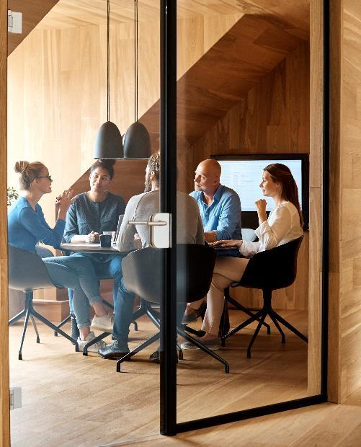



Introduction
We are here to show you what the best options for a specific person. (pc/laptop)

Slide 4

Getting Started
We hunted down all the important Information's on computers we could find to make the best decision for our client

Slide 5
Interview Description
The user was a student at Kerikeri high
He didn’t have much of a price range( nothing too expensive)
He wanted to document things
And it would also be used for gaming
And it would have to be portable

Slide 6
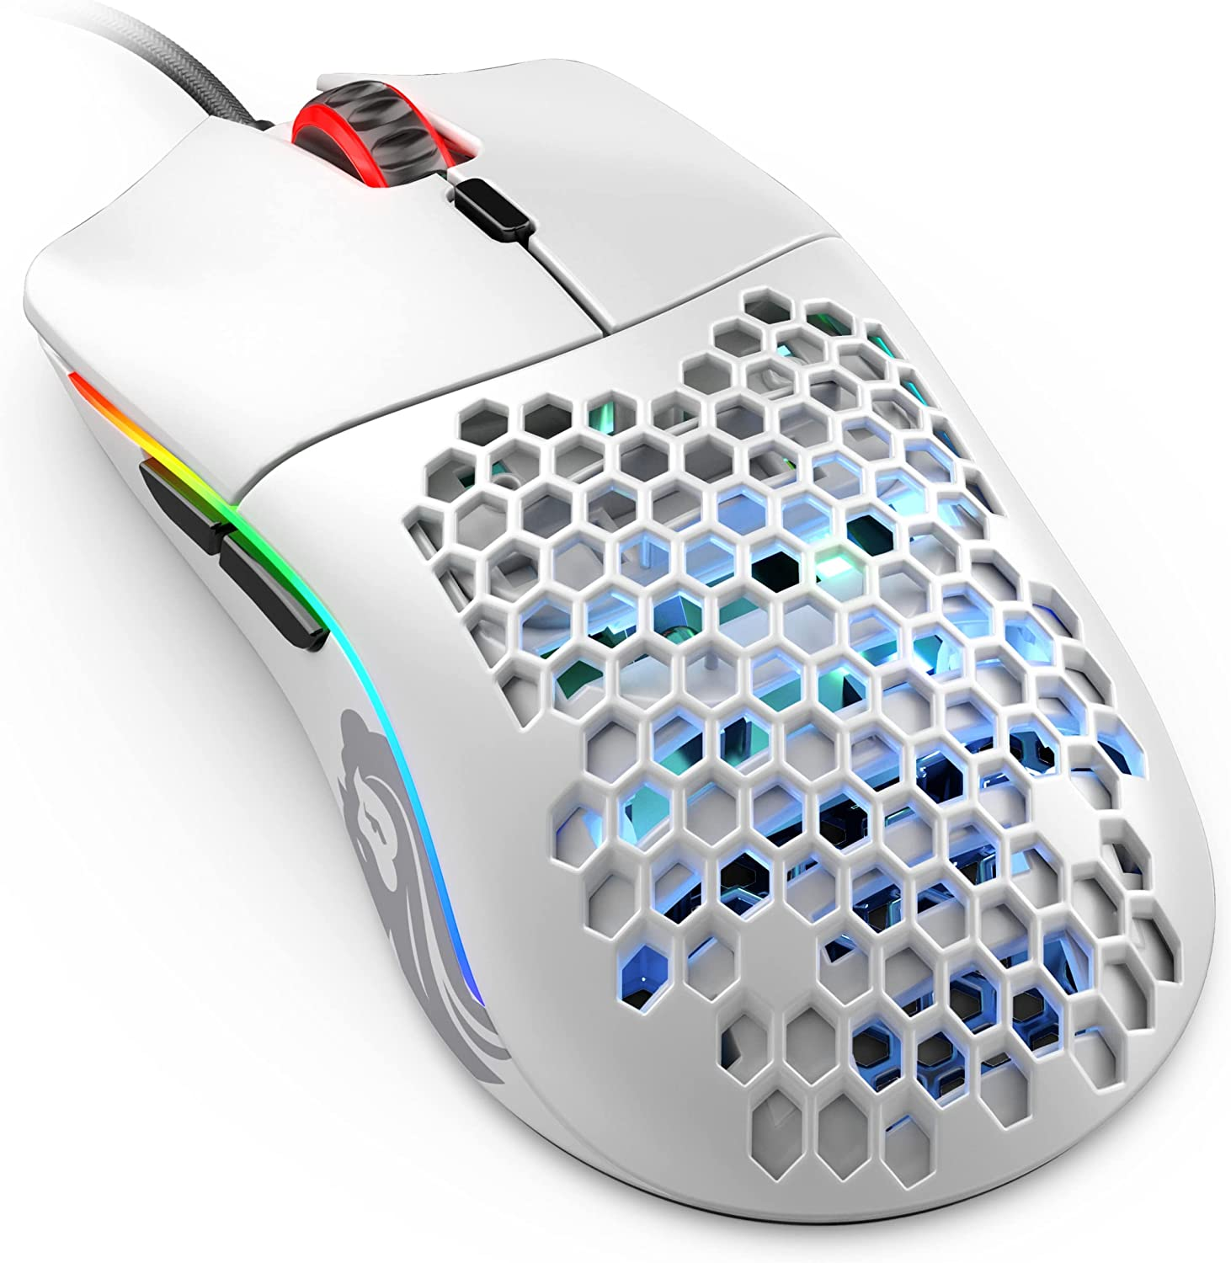
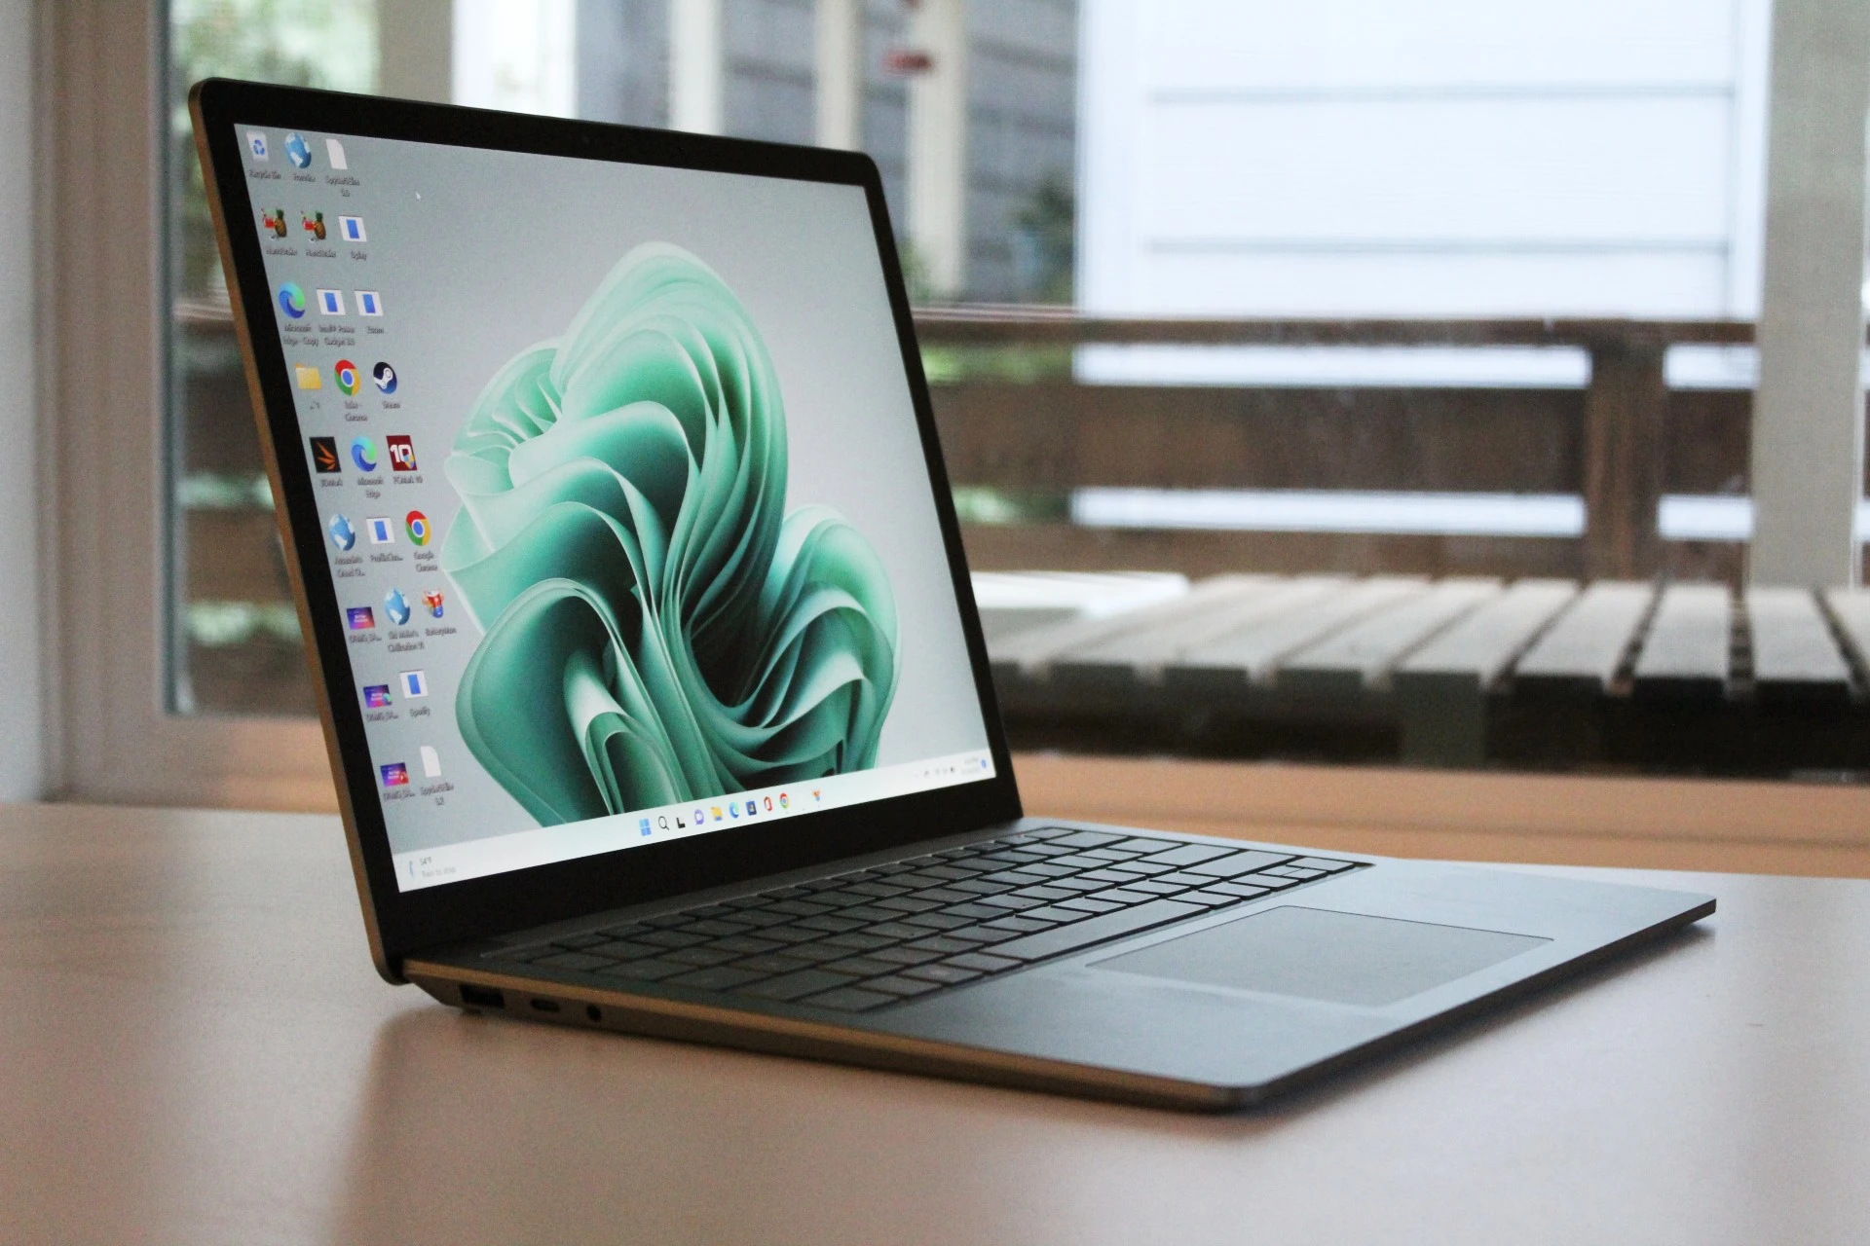
Selection
At first we scoured the internet for the best pc until we realized that he needed it to be portable
Surface Laptop 5 ($899)
Gaming mouse ($105)
SSD card ($59)

Slide 7
Justification
Laptop is portable and relatively cheap
Gaming mouse for gaming
And SSD card for more storage and space for games

Slide 8

Summary
This specific Student will get a laptop, SSD card and gaming mouse for only $ 1063

Slide 9



Thank You
Niels and lenny

Slide 10

bye

